Slide 1

TRANSCEND - caCIS
Integration Solution
June 2011

Slide 2
Contents
caCIS – Project Objectives
TRANSCEND-caCIS Integration
  Storyboards
  Integration Event Flow
Integration Solution
Integration Architecture

Slide 3
caCIS - Project Objectives
The caBIG® Clinical Information Suite (caCIS) project has two initial objectives:
  Enable source Clinical Applications to share the clinical data with target EHR systems, in multiple standard formats such as CDA R2, RIM ITS and HL7v2; and
  2. Transform the data received from the source Clinical Application into a standard canonical information model and store it in a data warehouse for subsequent analysis by researchers
While the TRANSCEND Tolven system will be the first source Clinical Application to use the caCIS solution, the solution will be designed to be generic and extensible such that it can be integrated with other source systems in future.

Slide 4
TRANSCEND – caCIS Integration – Storyboards
1. Transmit Data to a Study Site
The CRA working on TRANSCEND’s Tolven system enters data for one of the four clinical notes (baseline evaluation, clinical staging, medical study visit, surgical study visit) for the subject. Upon completion, the CRA determines that these notes need to be transmitted to the EPIC EMR system located at UPenn.
The user initiates a transfer request for the notes using TRANSCEND Tolven user interface by selecting the recipient (EPIC system at UPenn in this case), preferred mode of transfer (secure email, secure ftp, XDS NAV) as well as document format (HL7v2, RIM ITS, CDA R2) for the recipient.
This routing information, along with the actual clinical note (in the TRIM format), is transferred to the TRANSCEND-caCIS Semantic Adapter. The Semantic Adapter then converts the data to Canonical format and sends it to the caCIS Integration Platform.
The Integration Platform creates a document in the desired format and proceeds to send the document based on selected transfer mode (FTP). The Integration Platform also stores the data in Clinical Data Warehouse. The recipient system receives the data.

Slide 5
TRANSCEND – caCIS Integration - Storyboards
2. Transmit Data to a Physician
A physician on iSPY2 wants to send a patient for consultation to another physician. The iSPY2 physician selects appropriate clinical note for the patient and clicks a button on Tolven user interface for sending the data.
Tolven user interface presents a list of possible recipients, transfer modes (secure email, secure ftp, XDS NAV) and document formats (HL7v2, RIM ITS, CDA R2).
The user selects the name of the physician to send the Referral Consult Note to, the desired document format and Secure Email as the transfer mode. Tolven extracts related data and sends it to caCIS Semantic Adapter in the native TRIM format.
The Semantic Adapter converts the note into caCIS canonical format and sends it to the caCIS Integration Platform. The Integration Platform creates the document in the desired format, looks up the email address for the intended recipient physician and sends the document in an encrypted manner via secure email to the recipient.

Slide 6
TRANSCEND – caCIS Integration – Storyboards
3. Transmit Data for Warehousing and Analysis
Over a span of time on iSPY2 clinical trial, the CRAs enter data for multiple patients in TRANSCEND’s Tolven system. When a patient undergoing treatment either completes the treatment or chooses to discontinue treatment, the status of the patient changes to “off-study”. Most of the clinical data for such a patient needs to be loaded to the caCIS Clinical Data Warehouse to facilitate subsequent “Patient Outcomes” analysis by researchers.
TRANSCEND Tolven transmits data for the patients recently transitioned to off-study status to the TRANSCEND-caCIS Semantic Adapter. The Semantic Adapter transforms some of this data (Clinical Notes) from native Tolven format (TRIM) into the caCIS canonical format. Rest of the data cannot be transformed to the caCIS canonical format.
Semantic Adapter sends all of the data to the caCIS Integration Platform.
The Integration Platform stores the data in Clinical Data Warehouse and makes it available for research and analysis to authorized users.

Slide 7
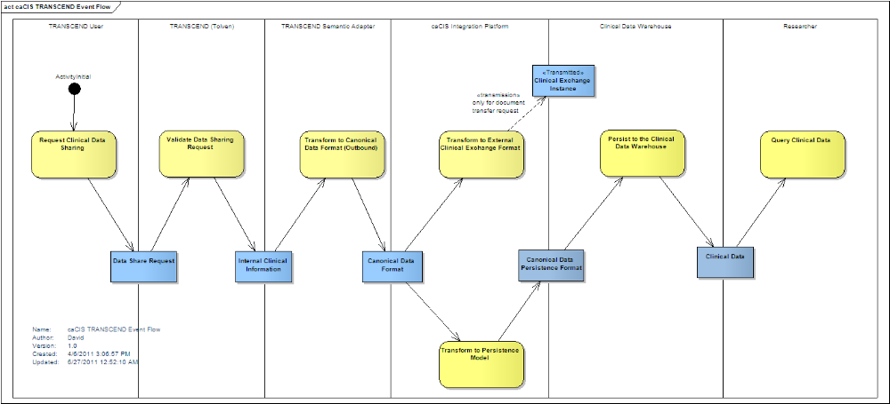
TRANSCEND – caCIS Integration – Event Flow
(Optimally Viewed in the Slide Show mode)

Slide 8
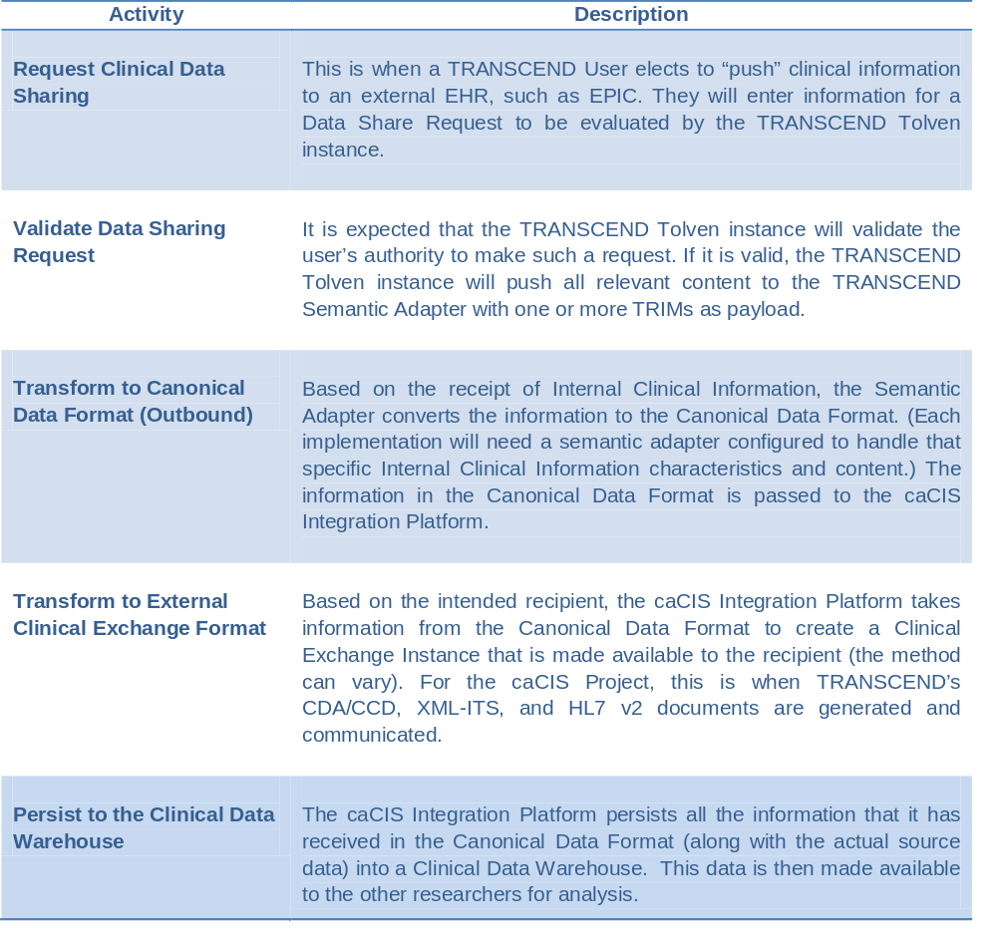
TRANSCEND – caCIS Integration – Event Flow

Slide 9
Proposed Integration Solution
Source System
(Tolven)
Secure Email
/ Secure FTP
Recipient/
Target System
Native
Format
(TRIM)
Integration Platform
Doc.
Transfer?
Semantic Adapter
Canonical
Model
Processor
XDS NAV
(Notification of availability)
Document
Router
Canonical
Model
Canonical
Model
Document
(Canonical
Model)
Extract
Transform
Load
OpenXDS
XDS
GET
Target
System
Clinical
Data
Clinical Data
Warehouse
Secured
Query
Interface
Clinical
Data

Slide 10
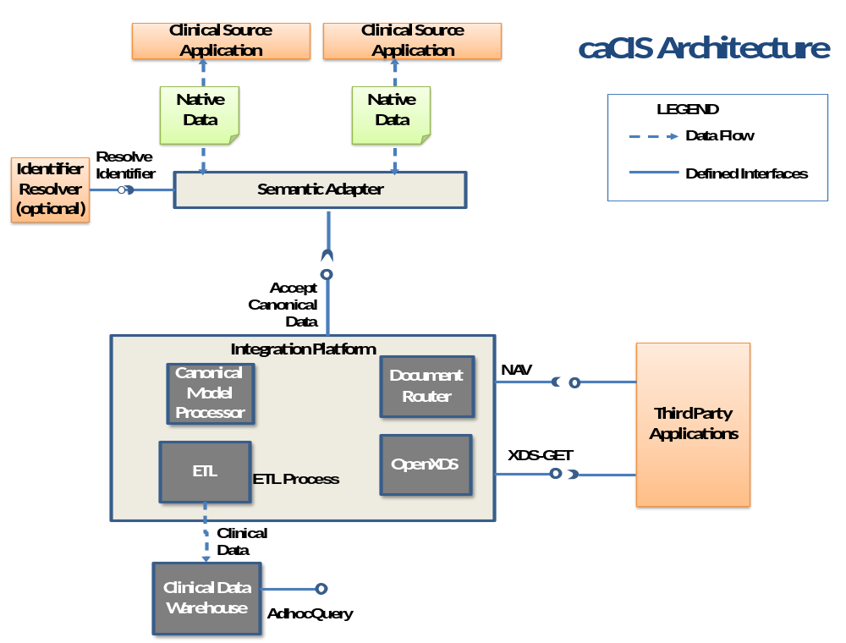
Doc. Transfer
Requests only

Slide 11
caCIS – Architectural Component - Definitions
No. | Term/Component | Definition
1. | Canonical format | Standards-based target data format that is used as a basis for creation of exchange instances and is also used to populate the Clinical Data Warehouse.
2. | Integration Platform (IP) | The overall caCIS infrastructure component that manages the verification of canonical information, generation and routing of exchange instances and management of transmission of data to the Clinical Data Warehouse. This is the component exposed to external systems involved in data exchange.
3. | Semantic Adapter (SA) | The component that transforms Clinical Data into the Canonical format.
4. | OpenXDS | OpenXDS implements the Cross-Document Sharing (XDS) Registry and Repository. It is used for delivery of data to recipient systems.
5. | Document Router | The caCIS integration platform component responsible for managing the creation of exchange instances and delivering them to their intended recipients.
6. | Canonical Model Processor | The caCIS infrastructure component responsible for receiving information from various source systems (via their individual Semantic Adapter), validating the input data, transforming it into the warehouse persistence format and passing it to the clinical data warehouse.
7. | Clinical Data Warehouse | The repository where the Integration Platform persists clinical data for ad hoc querying.

Slide 12
caCIS – Architectural Components - Implementation Details
No. | Term/Component | Implementation Details
1. | Canonical format | Based on CCD and other broadly used CDA R2 templates
2. | Integration Platform (IP) | Mirth Connect - open source standards-based healthcare integration engine that facilitates the routing, filtering, and transformation of messages between health information systems over a variety of protocols
3. | Semantic Adapter (SA) | Implementers can choose a platform that is acceptable to their enterprise. caCIS integration platform is loosely coupled with the SA and this provides the flexibility to choose any implementation platform for SA. TRANSCEND SA uses Mirth Connect and XSLT.
4. | OpenXDS | OpenExchange provided by MOSS (Misys Open Source Solutions)
5. | Document Router | Deployed as component of the Integration Platform (on Mirth Connect)
6. | Canonical Model Processor | Deployed as a component of the Integration Platform (on Mirth Connect)
7. | Clinical Data Warehouse | Virtuoso - RDF/Triple store

Slide 13
caCIS – Architectural Components – Data Formats
Semantic Adapter
Integration Platform
Document Recipients
Data Warehouse
caCIS Request
caCIS Request
CDA/CCD
RDF Graphs
Source Data
(Any format)
Routing Instructions
(Optional)
OR
HL7v2 Document
Routing Instructions
(Optional)
Meta Data
:
:
:
OR
Meta Data
(Optional)
Canonical Model Data and
Untransformed Source Data
RIM ITS

